Slide 1

Data Analysis for Marketing
By Naif Alzahrani

Slide 2
Data Solutions
Opening a new Branch
NY Metropolitan Area
Maximize Sales & Reduce Costs

Slide 3

Goals
Best Location
Best Month
Create a Daily Offers

Slide 4
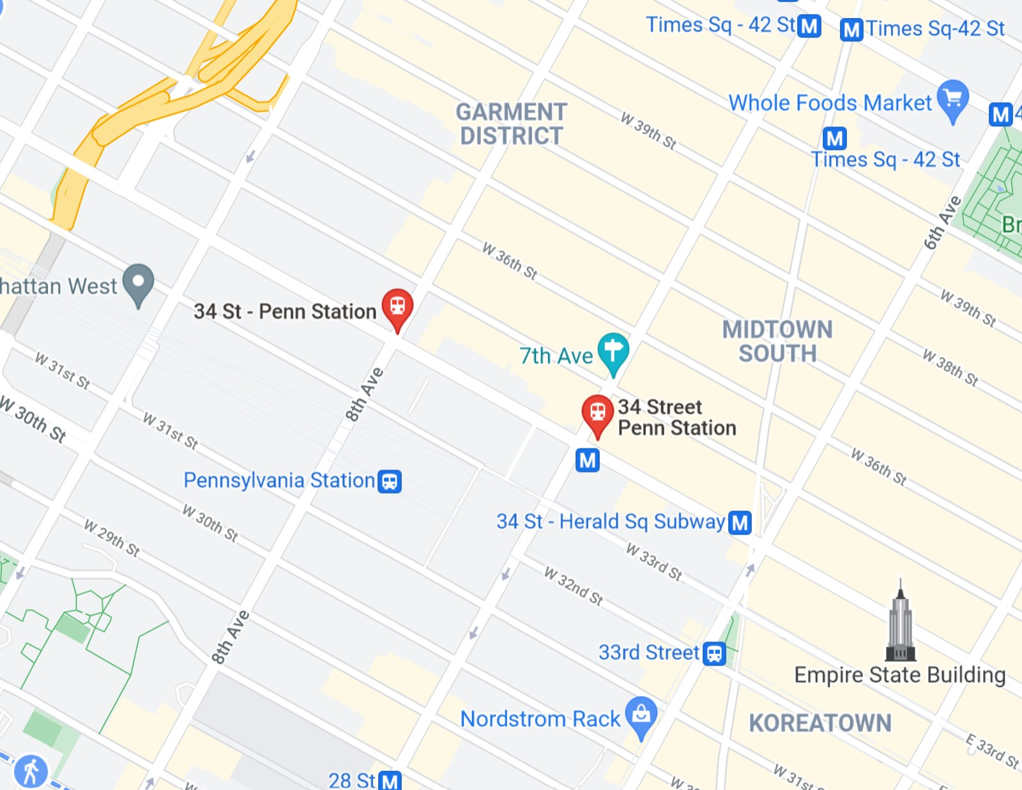
The Busiest Station
34 St Penn Station
The Lates Year 2021
All Months

Slide 5
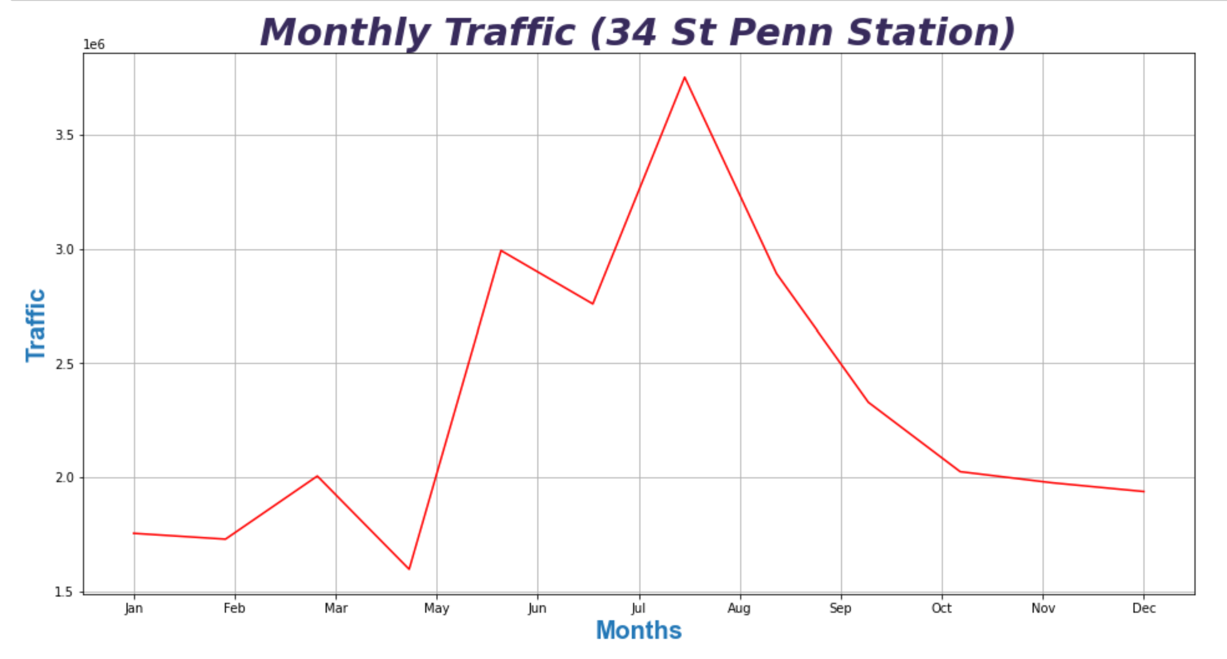

Slide 6
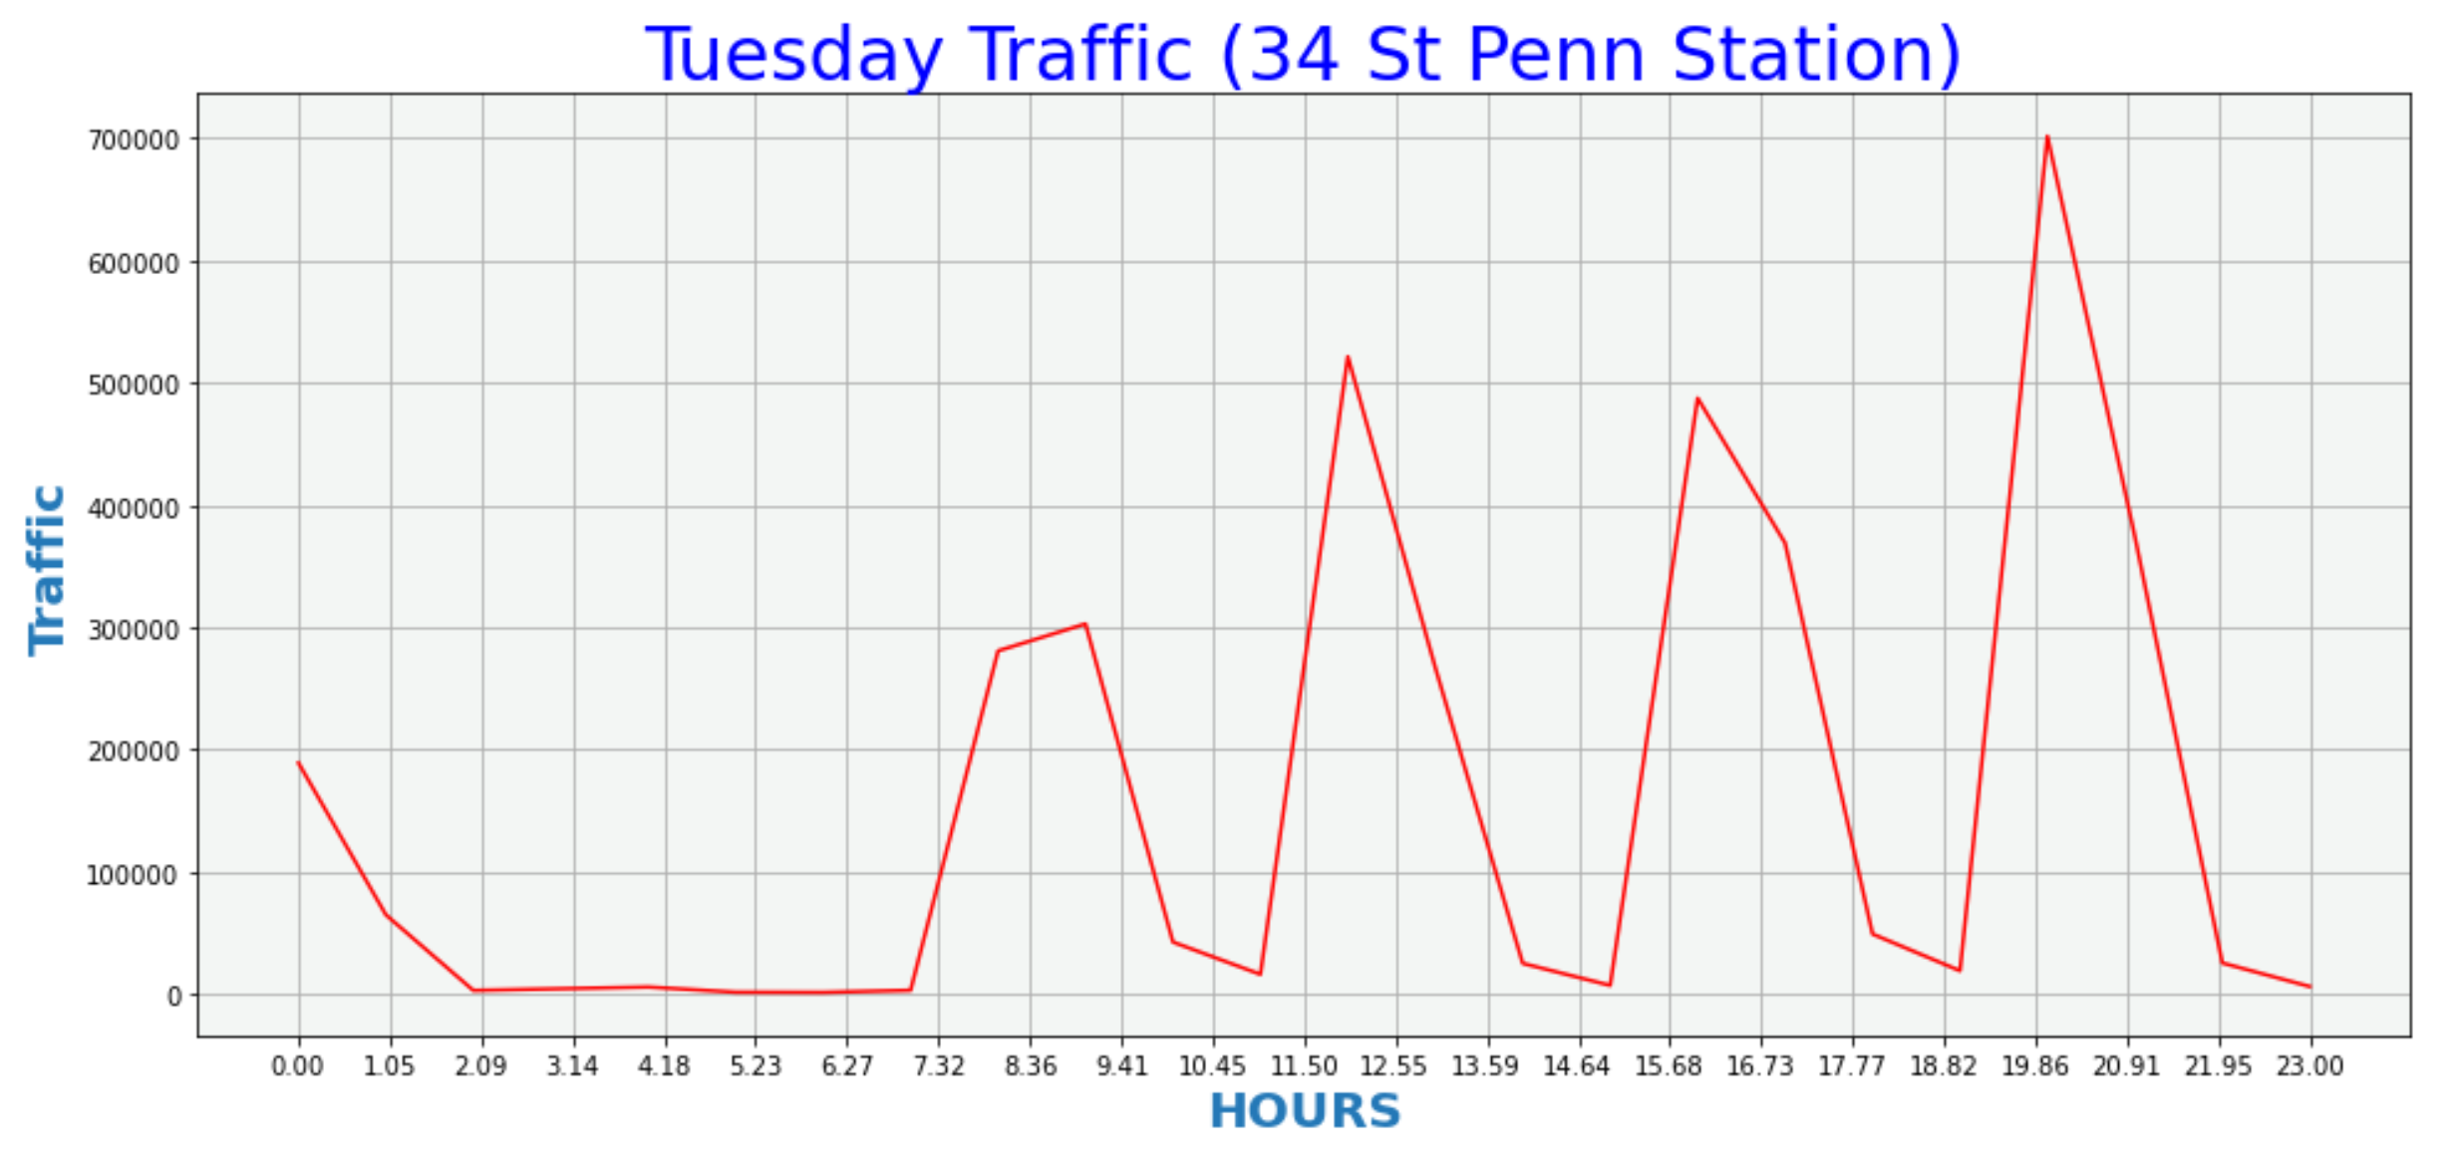

Slide 7
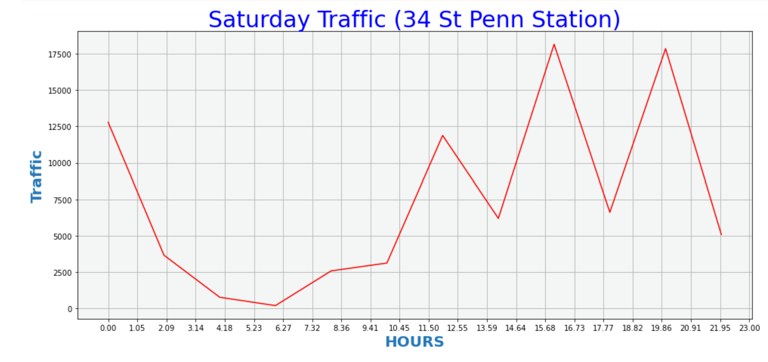

Slide 8
The End

